Slide 1
Diamonds Dataset Analysis
Exploring Patterns & Trends

Slide 2
Project analysis slide 2
Diamonds Dataset Analysis
Pre-Processing Analysis
Overview of Dataset
Agenda
Additional observations
Analysis Question
Diamond Related Data
Analysis Result

Slide 3
Overview of Dataset
1: Number of Rows and Columns
Our dataset consist a total of 154 rows.
Each row represents a distinct diamond with unique attributes.
We will explore relationship between these diamonds based up on certain key characteristics.
These insight could be valuable to acquire the knowledge to understand the patterns in the diamond market.

Slide 4
Overview of Dataset
2: Key Columns
It has following columns:
Carat: It represents the weight of the diamond.
Cut: It describes the cut quality of the diamond (e.g., Ideal, Premium or Good).
Color: It shows the color of the diamond (e.g., D to J).
Clarity: It shows the clarity of the diamond (e.g., IF, VVS1, VVS2, etc.).
Depth: It reflects to the depth percentage of the diamond."
Table: It shows the width of the table.
Price: It shows price of the diamond.

Slide 5
Overview of Dataset
3: Types of diamond-related data
We have a set of attributes which provides a holistic view of diamonds.
Carat, Cut, Color, Clarity, Depth, Table, and Price together offer insights into the quality, appearance, and market value of the diamonds.

Slide 6
Overview of Dataset
4: Potential Processing Steps
Before getting into our analysis of dataset, we took steps to ensure the reliability and accuracy of data.
We checked missing values, mistakes, and errors that could impact this analysis.
Categorical variables, such as Cut, Color, and Clarity, were handled accurately for purposeful insights.
Numerical values were normalized to maintain consistency of data and to facilitate comparison.

Slide 7
Analysis Question
Q: What is relationship between price and carat?
Our main exploration revolves around understanding how the weight of a diamond (Carat) influences market price.
Carat is an important factor in determining the value of a diamond, our goal is to show the nature of its relationship with the price.
This question was selected because it demonstrate an important aspect of the diamond market and provide insight that can be valuable for consumers and industry professionals.
By exploring this relationship, we can understand pricing trends more better and potentially predict how changes in carat weight may influence the value of diamonds in the market.

Slide 8
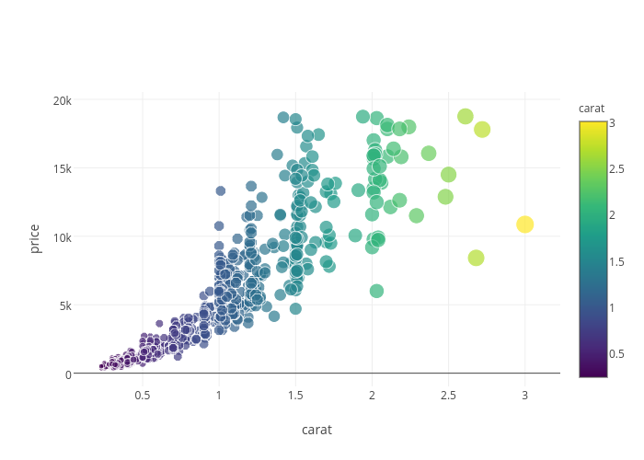
Price Vs Carat
Result Analysis

Slide 9
Project analysis slide 5
Result Analysis
Price
Carat
.

Slide 10
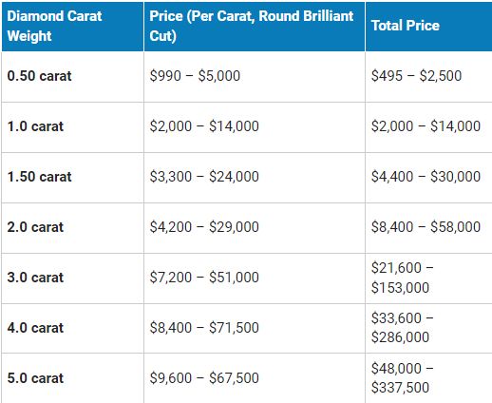
Current Diamond Price Chart-2023

Slide 11
Project analysis slide 8
Result Analysis
Carat Vs Price
Trends and Patterns
Our scatter plot, with Carat on the x-axis and Price on the y-axis, offers a visual representation of the relationship between these two key attributes. Each data point showcasing its carat weight and the associated prices. The scatter plot allows us to observe the overall trends or clusters.
Close examination of the scatter plot shows that diamonds within a specific carat range tend to exhibit similar pricing.
For instance, we usually observe that as carat weight increases, there is a noticeable upward rise in pricing.
Correlation Analysis
Insights and Implication
We calculated the correlation coefficient to show the relationship between carat and price.
The correlation coefficient measures the strength and direction of the linear relationship between two variables.
In our analysis case, a positive correlation coefficient suggests that as carat weight increases, the price tends to increase as well.
Our analysis indicates a positive correlation.
This implies that, as the carat weight of a diamond increases, its market price tends to rise as well.
Knowing this relationship has major implications for consumers, jewelers, and professionals.

Slide 12
Summary
Conclusion
In summary, our analysis showed a positive correlation between Carat and Price in the diamond dataset.
The scatter plot visually demonstrated how changes in carat weight correspond to shifts in pricing.
This insight is important for stakeholders in the diamond industry to get the core factors impacting market prices.

Slide 13
Implications of Result
Conclusion
The correlation has significant implications for both consumers and professionals.
Consumers can use this information to make more informed decisions about their diamond purchases because they will consider the impact of carat weight on pricing.
In case of sellers and jewelers, getting knowledge of the correlation allows for strategic pricing strategies based on the carat weight of diamonds.
This insight empowers stakeholders to navigate the market more effectively and adapt to changing consumer preferences.

Slide 14
Challenges Encountered
Conclusion
It's essential to admire that the relationship between Carat and Price is complex, with additional factors influencing pricing dynamics.
These unexpected findings or challenges allows for a more nuanced interpretation of the results.

Slide 15
Significance of Analysis
Conclusion
Our analysis offers a valuable contribution in understanding the diamond pricing trends.
By showing the relationship between Carat and Price, we provided insights for industry persons to adapt to market dynamics.
This analysis serves as a base for future research, encouraging a deep exploration of factors that contribute to the intricate pricing landscape.
Ultimately, the significance of this analysis lies in its potential to inform decision-making and enhance market transparency.

Slide 16
Thank You
"As diamonds are shaped by nature's forces, data is shaped by analytical minds. Both processes unveil unique facets of brilliance."

